Slide 1
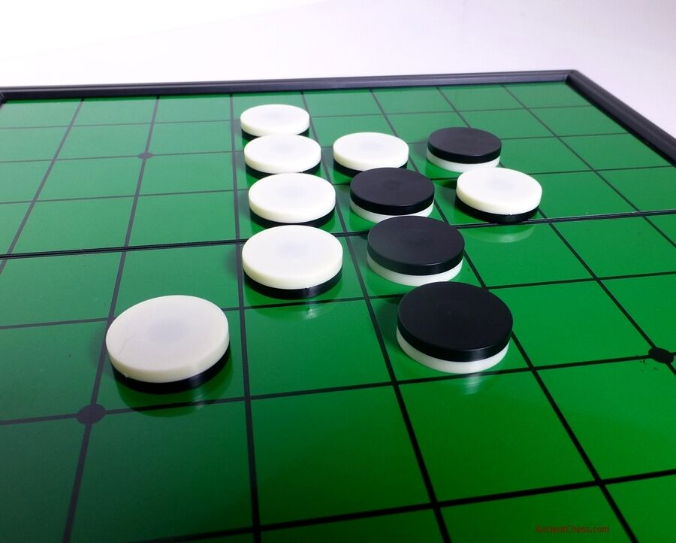
Othello
An AI-project by a bunch of amateurs

Slide 2
Members of our Group:
Vũ Công Duy
Đào Hồng Quân
Phạm Ngọc Diễn
Đoàn Minh Đức

Slide 3
Contents:
Introduction of the game
Algorithms for the AI
Graphic User Interface
Conclusions
Questions & Answers

Slide 4
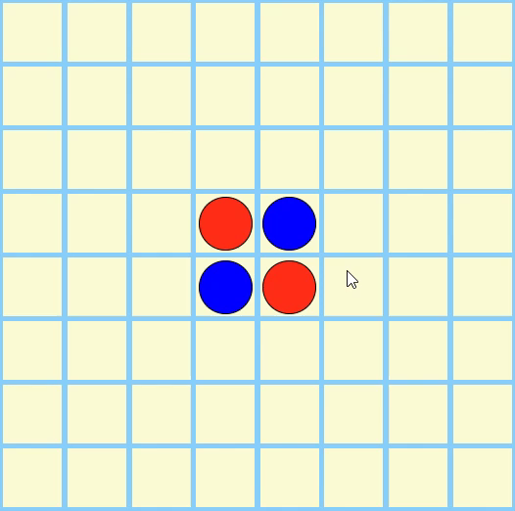
1. INTRODUCTION:
Othello is a classical strategy board game for two
players, played on an 8x8 uncheckered board.
The rules state that the game begins with 4 disks
placed in 4 central squares like in Fig.1.
Players take turns placing disks on the board with
their assigned color facing up.
Any disks of the opponent’s color that are in a
straight line and bounded by the disk just placed
and another disk of the current player’s color are
turned over to the current player’s color.
Player can only place 1 disks each turn where at
least one opponent’s disk can be reversed.
Figure 1

Slide 5
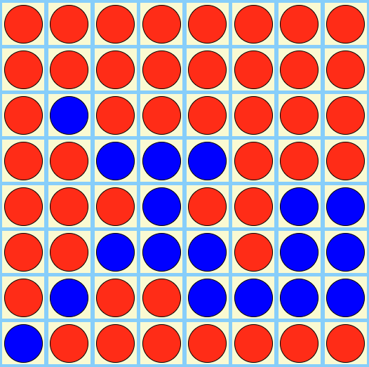
1. INTRODUCTION:
The object of the game is to have the majority of disks turned to display
your color when the last playable empty square
is filled. In Fig.2, Red: 46 wins over Blue: 18.
If one player can not make a valid move, the
turn passes back to the other player.
When neither player can move, the game ends.
Figure 2

Slide 6
1. INTRODUCTION:
Our game has 6 levels:
- Level 1: Random
- Level 2: Counting pieces
- Level 3: Local maximization
- Level 4: Minimax with depth 3
- Level 5: Alpha-Beta pruning with depth 5
- Level 6: Alpha-Beta pruning with sorted nodes and depth 7

Slide 7
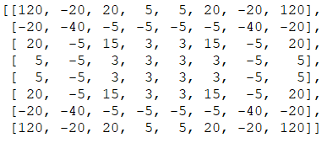
II. ALGORITHMS:
1. Random:
The easiest level for the computer’s difficulty is by randomly choosing a move from the list of available moves.
2. Counting pieces:
The computer goes through the list of available moves and picks out the move that gains the most pieces.
3. Local maximization:
Using a value board, the computer checks for the move that has the highest reward, according to the value board (Fig. 3).
Figure 3

Slide 8
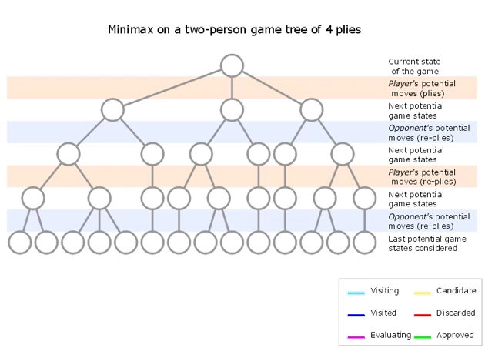
II. ALGORITHMS:
4. Minimax:
This is a recursive function with three parameters: board, depth and player.
The base case returns the evaluating value.
The maximizing instance checks for the player’s move that gains the most value by simulating a move as the player.
The minimizing instance checks for the player’s move that gains the least value by simulating a move as the opponent.

Slide 9
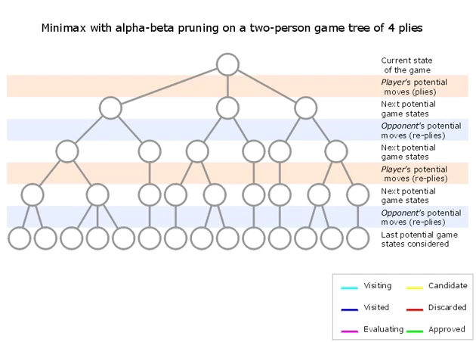
II. ALGORITHMS:
5. Alpha-Beta pruning:
This function is an improved version of minimax and has two new parameters: alpha and beta.
The base case remains the same.
Alpha represents the highest value for a move in the node.
Beta represents the highest value for a move under the opponent’s restriction in the parent node.
In the maximizing instance, the returned value is assigned to alpha if alpha is smaller.
In the minimizing instance, the returned value is assigned to beta if beta is larger.
Both cases break when the alpha is larger than the beta.

Slide 10
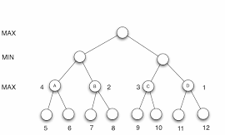
II. ALGORITHMS:
6. Alpha-Beta pruning with sorted nodes:
This is an enhance version of alpha-beta pruning.
The main difference is that the available moves list is sorted descendingly.
During the maximizing instance, the alpha will likely appear first.
During the minimizing instance, the beta will likely appear first.
MAX
MIN
3
2
MAX
3
5
2
4
3
2
5
1
2
2
4
3

Slide 11
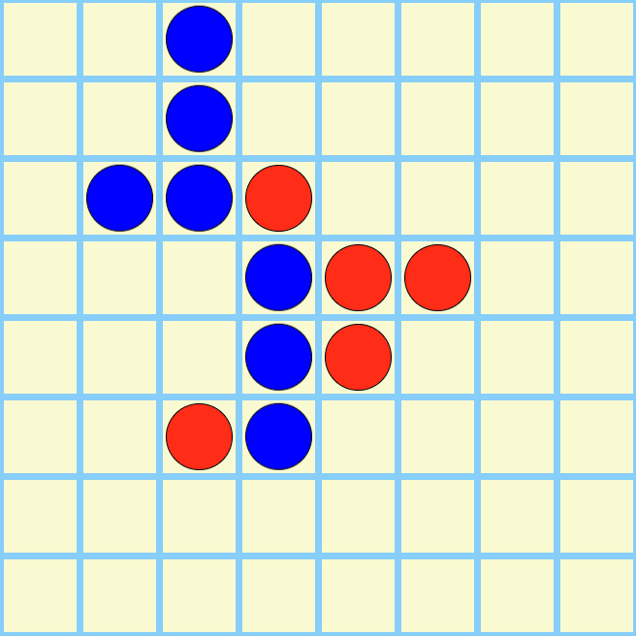
II. ALGORITHMS:
7. Heuristic:
We evaluate of the game according to the game board and the value board.
For every tile with the player’s disk, the value is incremented with its reward.
For every tile with the opponent’s disk, the value is decremented with its reward.

Slide 12
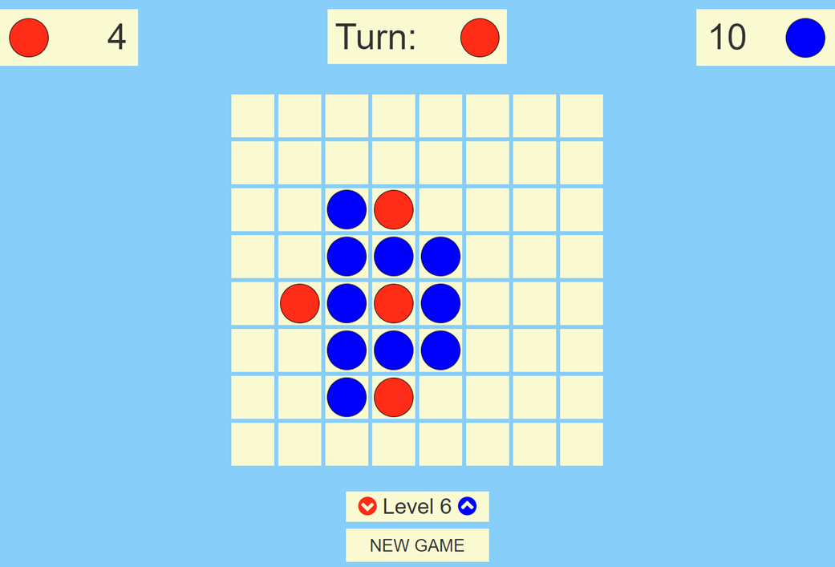
III. Graphic User Interface:
The game is displayed as a Chrome app with HTML, CSS, and JavaScript.
We also use the framework Bootstrap 3 to help with the grid system.
The Python library EEL helps set up a server and allows JavaScript to call Python functions in asynchronous calls.
In the game, the player can choose to reset the game at will.
During each of the player’s turn, you can adjust the difficulty of the game from level one to six.

Slide 13
IV. CONCLUSIONS:
The algorithms we've discussed are very general and are applicable to a broad range of strategy games, such as Chess, Checkers, and Go.
There are more advanced algorithms for Othello exist that apply various gameplay heuristics.
Some of these are discussed in “Searching Algorithms in Playing Othello” by Zhifei Zhang and Yuechuan Chen.

Slide 14
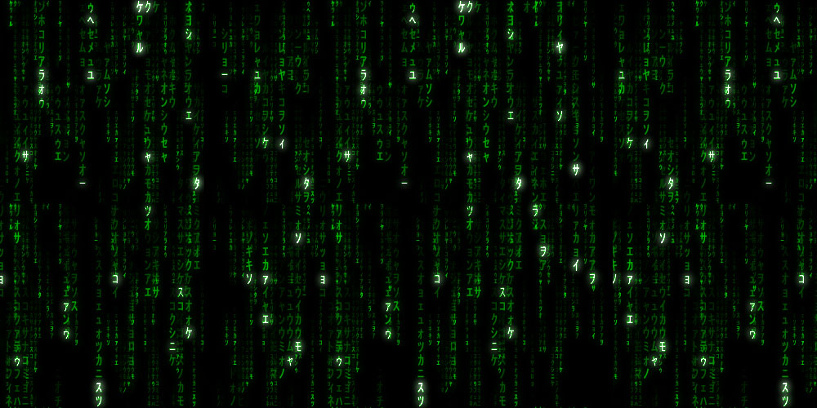
QUESTION & ANSWERS
This Photo by Unknown Author is licensed under CC BY-SA
This Photo by Unknown Author is licensed under CC BY-SA-NC

